Slide 1

Project: Feature Extraction and Price Prediction for Mobile Phones
Raushan kumar

Slide 2

Project Description
In this project, you will work with a dataset that contains detailed information about various mobile phones, including their model, colour, memory, RAM, battery capacity, rear camera specifications, front camera specifications, presence of AI lens, mobile height, processor, and, most importantly, the price. Your primary goal is to develop a predictive model for mobile phone prices.

Slide 3

Instruction
1.Data Exploration Analysis
2.Data Preprocessing
4.Model Building
5.Model Evaluation
3.Feature Extraction
6.Feature Importance Analysis

Slide 4

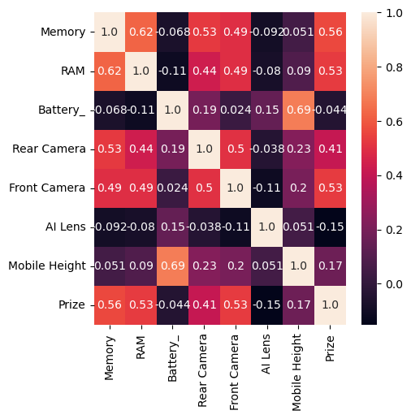
Data Exploration Analysis
Data Exploration Analysis
Check the dimension of the datasets. Then 541 Rows and 12 Columns.
Check the missing value in our dataset. Then No Missing value in the dataset.
Get The Brief Information of Dataset.Then Thera are datatypes: float64(1), int64(5), object(6)
Check the describe function to get the descriptive statistics of Numerical features.
I check the correlation between features and target variables.
Memory | RAM | Battery_ | Rear Camera | Front Camera | AI Lens | Mobile Height | Prize
count | 530 | 530 | 530 | 530 | 530 | 530 | 530
mean | 111.0038 | 5.403774 | 4871.753 | 46.29057 | 12.05849 | 0.062264 | 16.44943
std | 60.89617 | 1.992231 | 765.0386 | 31.38851 | 9.108585 | 0.241863 | 2.496566
min | 16 | 2 | 800 | 0 | 0 | 0 | 4.5
25% | 64 | 4 | 5000 | 13 | 5 | 0 | 16.51
50% | 128 | 6 | 5000 | 50 | 8 | 0 | 16.71
75% | 128 | 8 | 5000 | 50 | 16 | 0 | 16.94
max | 256 | 8 | 7000 | 200 | 60 | 1 | 41.94
df.corr()['Prize']
Memory | 0.563008
RAM | 0.528962
Battery_ | -0.044061
Rear Camera | 0.405817
Front Camera | 0.528442
AI Lens | -0.152557
Mobile Height | 0.168610
Prize | 1.000000
Name: Prize, dtype: float64

Slide 5

Data Preprocessing
Data Preprocessing
Processing the Prize column remove Comma and convert object column to numerical column.by using the string function.
Prize was this type-7,559
Now Prize is this type-7559
Processing the column Rear Camera & Front Camera .And Convert the datatype(object) to numerical column.by using the lambda function.
Rear Camera & Front Camera was this type -16MP
Now Rear Camera & Front Camera is this type-16
Find outliers and remove the outliers using the quantile method.
Convert the categorical columns into Numerical columns using the 1 . One-Hot Encoding.
Columns like this:-
Model
Colour
Processor brand
Final Clean data is like this type
Data visualization important columns with respect to Target veritable.
 | Modal | Colour | Memory | RAM | Battery_ | Rear Camera | Front Camera | AI Lens | Mobile Height | Prize | Processor brand
0 | Infinix SMART 7 | Azure Blue | 64 | 4 | 6000 | 13 | 5 | 1 | 16.76 | 7299 | Unison SpreadTrum
1 | MOTOROLA G32 | Mineral Gray | 128 | 8 | 5000 | 50 | 16 | 0 | 16.64 | 11999 | Qualcomm Snapdragon
2 | POCO C50 | Royal Blue | 32 | 2 | 5000 | 8 | 5 | 0 | 16.56 | 5649 | Mediatek Helio
3 | Infinix HOT 30i | Marigold | 128 | 8 | 5000 | 50 | 5 | 1 | 16.76 | 8999 | G37

Slide 6

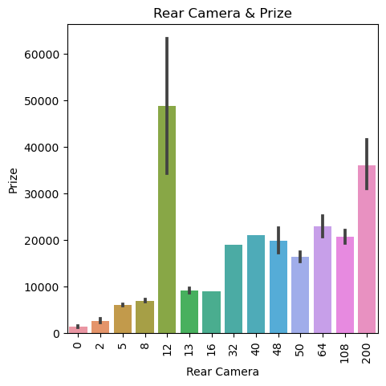
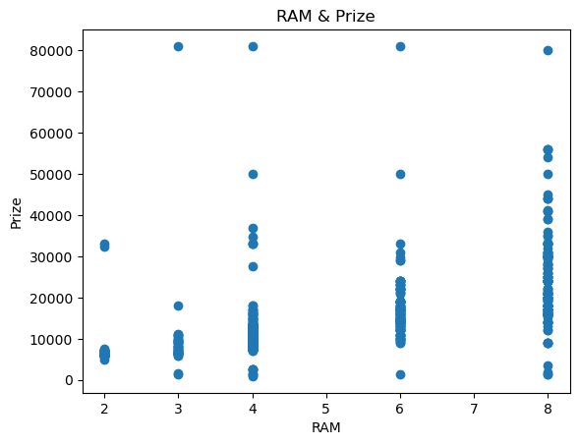
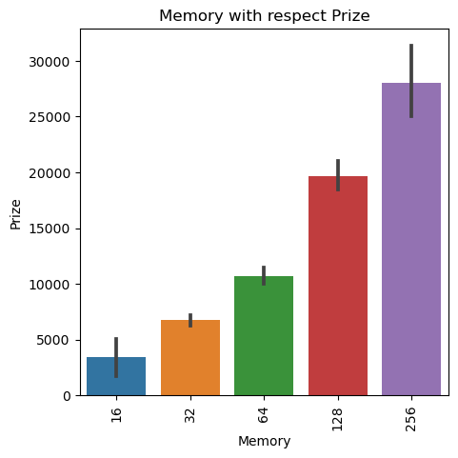
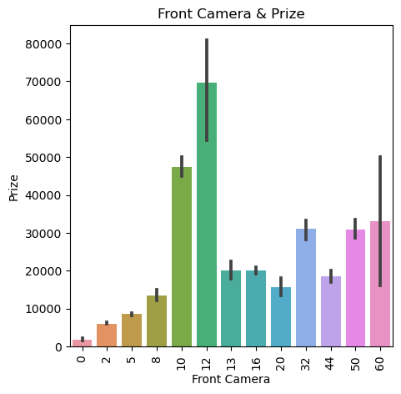
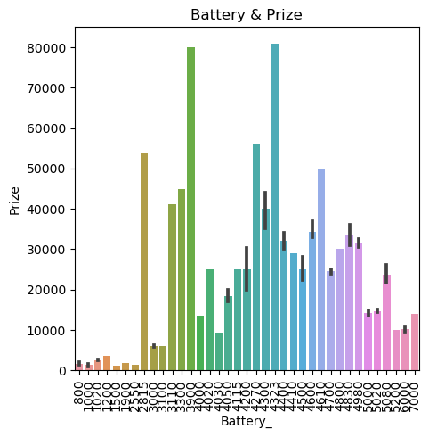
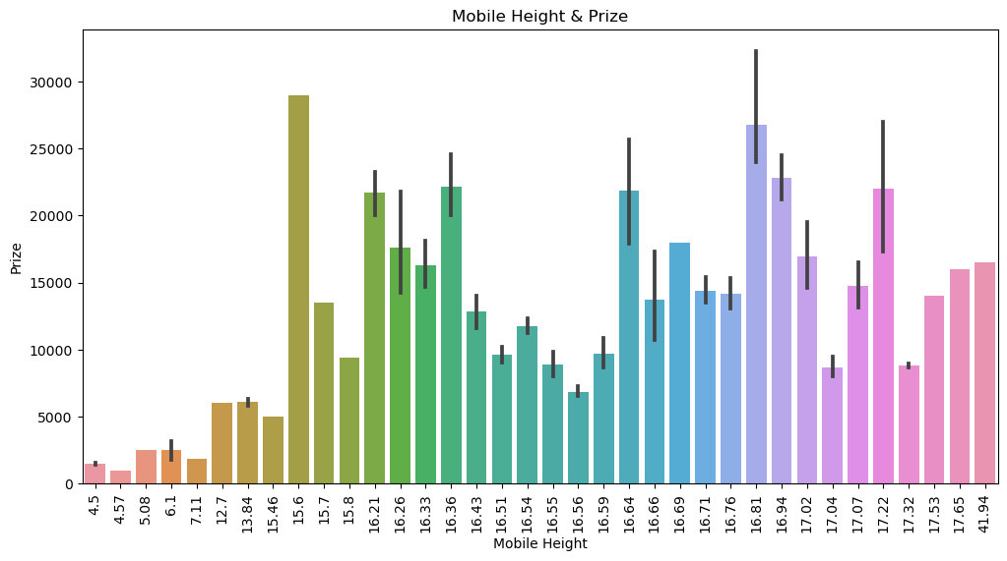
Data visualization important columns with respect to Target veritable.
Analysis of data by visualisation Rear camera & Prize Analysis of data by visualisation RAM camera & Prize Analysis of data by visualisation memory & Prize
Rear camera 12 MP Prize is high 50,000 and rest rest Rear camera(MP) prize under 20,000. Mobile RAM has continuous increase then prize is increase. Mobile Memory has continuous increase then prize is increase.
Analysis of data by visualisation Front camera & Prize Analysis of data by visualisation battery $ Prize. Analysis of data by visualisation Mobile hight $ Prize.

Slide 7
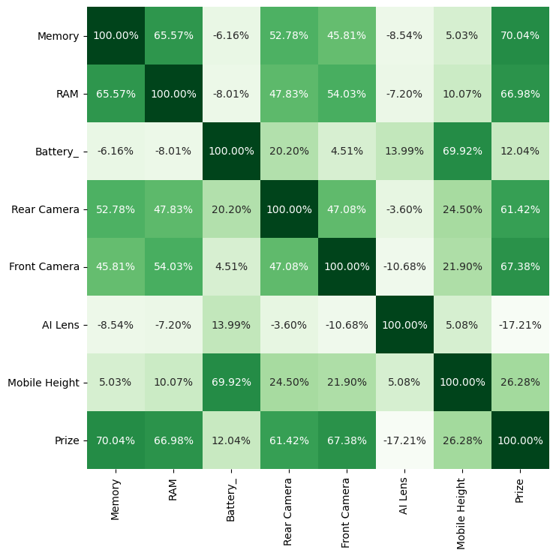
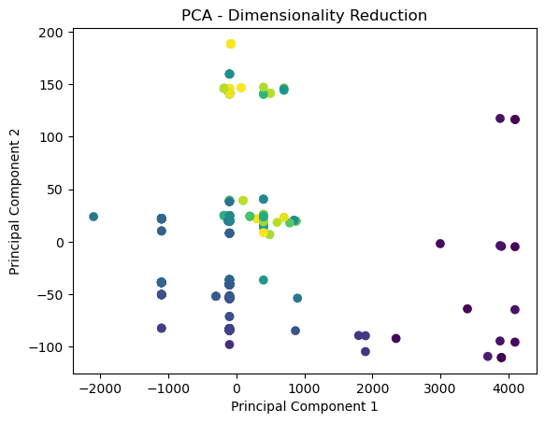
Feature Extraction:
Feature extraction using correlation analysis. Feature Extraction Using PCA Algorithms and dimensionality
reduction.
Feature selection using mutual_info_regression.

Slide 8
Model Building
Linear Regression
AdaBoost Regressor
Gradient Boosting Regressor
Decision Tree Regressor
Random Forest Regressor

Slide 9
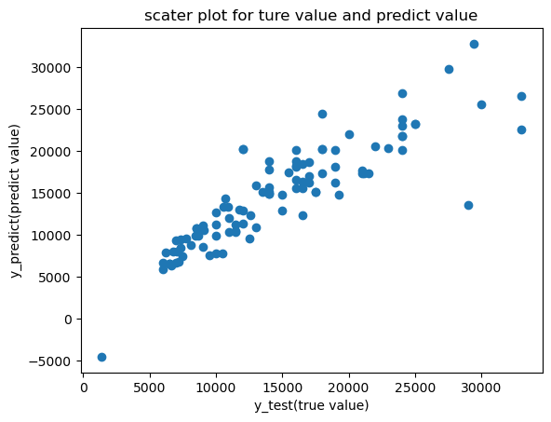
Linear Regression algorithms
Linear Regression algorithms
X train y train Score 0.79
X test y test Score
0.79

Slide 10
Model Building AdaBoost Regressor, Gradient Boosting Regressor And Decision Tree Regressor
AdaBoost Regressor
Gradient Boosting Regressor
Decision Tree Regressor
X train y train Score = 0.79
X test y test Score = 0.72
X train y train Score = 0.92
X test y test Score = 0.86
X train y train Score = 0.99
X test y test Score =0.65

Slide 11
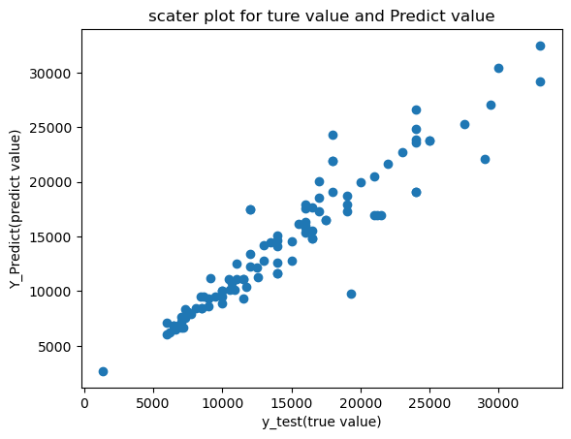
Model Building Random Forest Regressor
X train y train Score =0.98
X test y test Score = 0.88
Random Forest Regressor
Random Forest Regressor is the best algorithm for this Dataset accuracy good .

Slide 12
Model Evaluation: Predict The value using Random Forest Regressor algorithms
MAE = Mean absolute error
MSE = Mean Squared error
RMSE = Root Mean Squared Error
1402.16
4889506.69
2211.22

Slide 13


Raushan kumar Project Presentation Complete

